Slide 1


Iviwe Sondlo (ST10440972)
Weather App (Sky Limit)

Slide 2
Purpose
The purpose of the application is for the user to enter data about the weather on a specific day and the app takes that data and calculates the average temperature of that specific day.

Slide 3
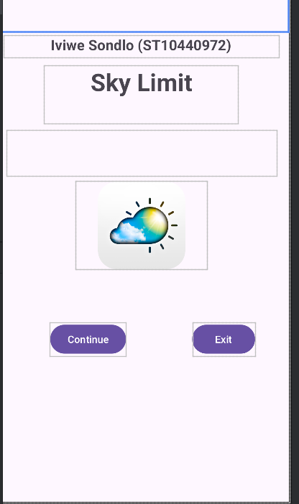
Splash Screen
This is the welcome screen

Slide 4
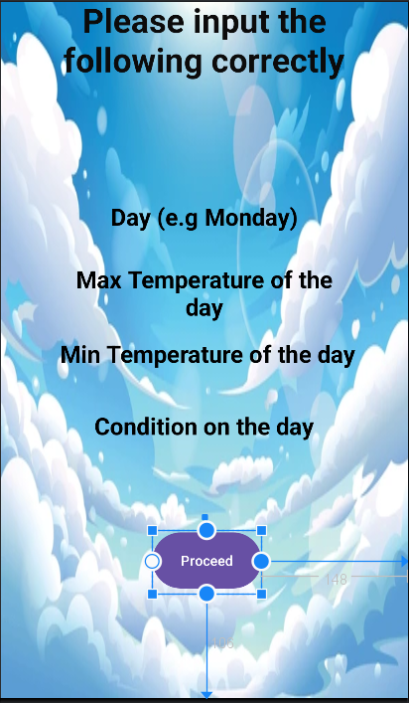
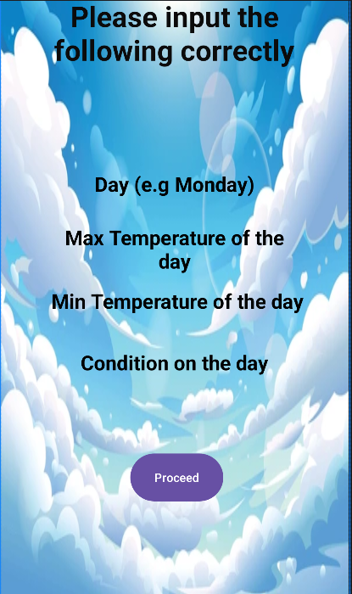
Main Screen
This screen is where you input the data of a specific day

Slide 5
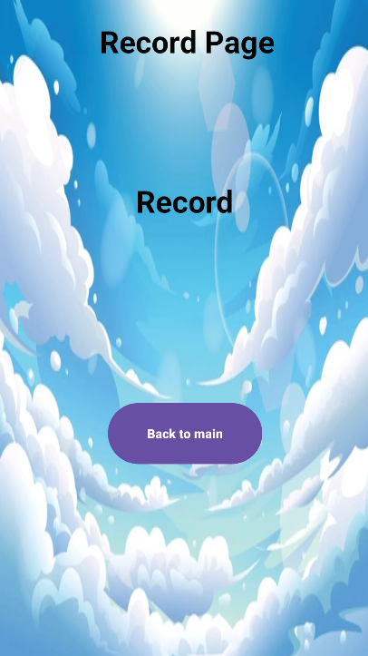
Record Screen
This screen is where the app shows you the average temperature

